Slide 1
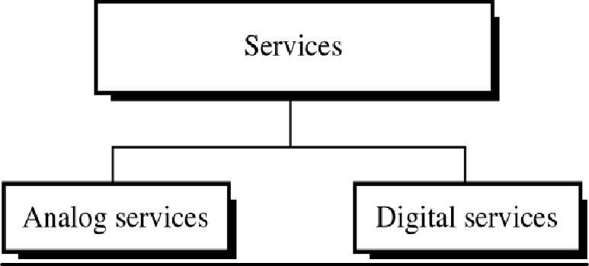
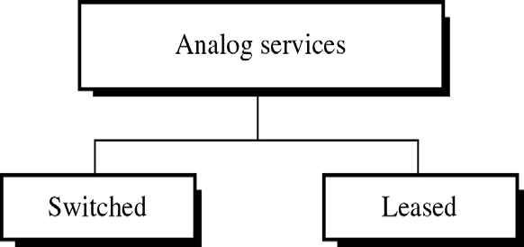
CS601-Data Communication
VU
LECTURE #31
Telephone Services
Common carrier Services & Hierarchies
Telephone companies began by providing their subscribers with ANALOG services using ANALOG networks
Later digital services were introduced
Nowadays carriers are even thinking about changing their service lines digital too
Soon the entire n/w will be digital
For now both types of services are available and both FDM and TDM are in use
Analog Services
Of the many analog services available to telephone subscribers, two are really important:
–Switched Analog Services
–Leased Analog Services
Familiar dial up service most often encountered when using a home telephone
Uses twisted pair cable to connect subscriber’s phone to the network via exchange
This connection is called LOCAL LOOP
The n/w it joins is called PSTN
Signal on a local loop is Analog and BW is usually b/w 0 and 4000 Hz
o
160

Slide 2
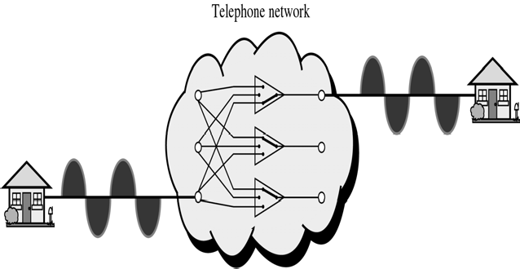
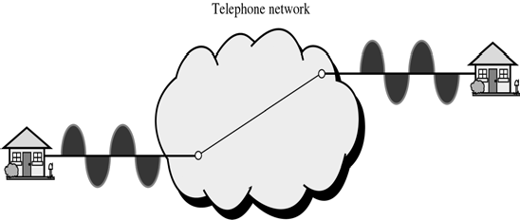
CS601-Data Communication
VU
Switched Analog Services
With switched lines, caller dials a number and call is conveyed to a series of switches at the exchange
The switch connects two lines for the duration of the call
Analog Leased Service
Offers customers the opportunity to lease a line, sometimes called a Dedicated Line
Dedicated line is permanently connected to the other customer Although the connection still passes through switches in the exchange, the customer experiences it as a single line because switch is always closed
No dialing is needed
Conditioned Lines
Another service offered by the carriers
Conditioning means improving the quality of a line by lessening attenuation, signal distortion or delay distortion
Conditional lines are Analog but their quality makes them suitable for digital data communication when connected to Modems
Analog Hierarchy
To maximize efficiency, telephone companies multiplex signal from lower BW lines onto higher BW lines
In this way many switched or leased lines can be combined into fewer but bigger channels
FDM is used for analog lines

Slide 3
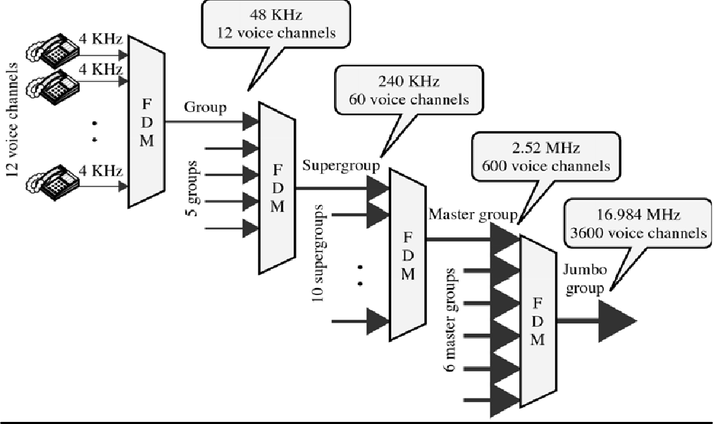
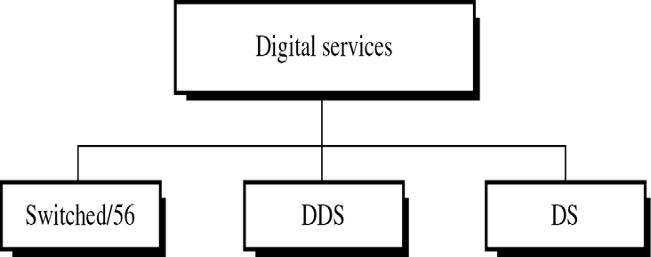
CS601-Data Communication
VU
Digital Services
Digital services are largely offered nowadays
Digital services are less sensitive than analog ones
Telephone line acts as an antenna and pick up noise both in case of analog and digital TX
In analog, both noise and signal are analog
In digital, signal can easily be separated
Types of Digital Services
Switched / 56 Service
It is digital version of Analog switched line Allows data rates of up to 56 Kbps
Both parties must subscribe to the service
A caller with normal telephone service cannot connect to a telephone or computer with this service even with a Modem

Slide 4
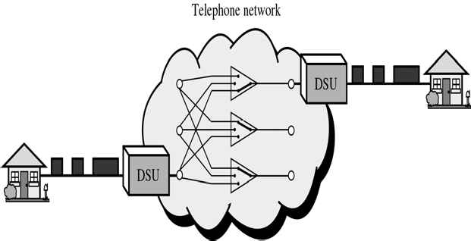
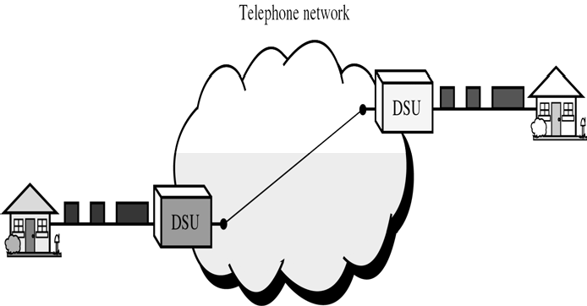
CS601-Data Communication
VU
Because this service is already digital, subscribers do not need modems They need DSU (Digital service unit)
DSU changes the rate of digital data created by the subscriber’s device to 56 Kbps and encodes it in the format used by service provider
DSU is often included in dialing process DSU is more expensive than Modem
So why would a subscriber pay for switched/56 service and DSU? Because digital line has better speed, better quality and less susceptibility to noise
Bandwidth on Demand
Digital Data Service (DDS) Digital version of analog leased line Max. data rate of 64 Kbps
Like switched/56, DDS requires a DSU
DSU for this service is cheaper than switched /56 DSU because it does not need a dial pad
Digital Signal (DS) Service
Telephone companies saw the need to develop a hierarchy of digital services much like those used for Analog services
The next step was DS service
DS is a hierarchy of digital signals

Slide 5
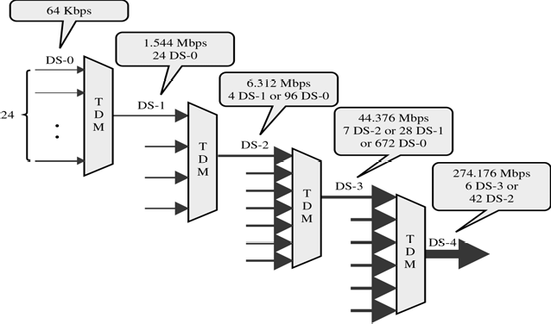
CS601-Data Communication
VU
DS-0 resembles DDS. It is single digital channel of 64 Kbps
DS-1 is 1.544 Mbps service = 24 * 64 Kbps+8 Kbps of overhead DS-2 €6.312 Mbps=96*64 Kbps + 168Kbps
DS-3 €44.376 Mbps=672*64Kbps +1.368 Mbps of overhead DS-4 €274.176Mbps4032 * 64 Kbps+ 16.128Mbps overhead
T Lines
DS-0 DS1 are the names of the Services
To implement those services, telephone companies use T-lines
These are the lines with capacities matched to the data rates of DS-0 to DS-4
ServiceLine
Rate(Mbps) Voice channels
--------------------------------------------------------
DS-1 DS-2 DS-3 DS-4
T-1 1.544 T-2 6.312
T-3 44.736 T-4 274.176
24
96
672
4032
Summary
The Telephone System
Analog Services
Digital Services
Fiber To The Curb (FTTC)
Reading Sections
Section 8.5, “Data Communications and Networking” 4th Edition by Behrouz A. Forouzan

Slide 6
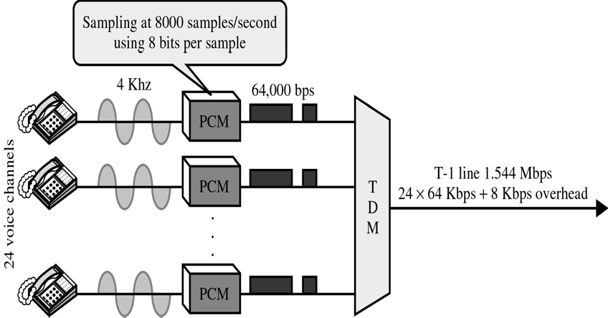
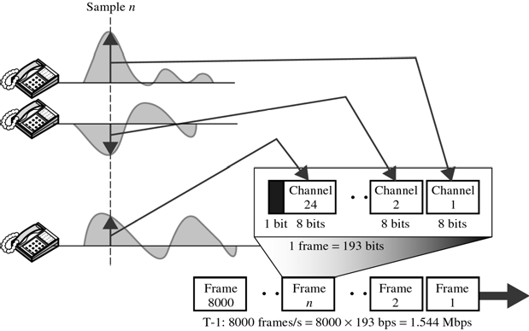
CS601-Data Communication
VU
LECTURE #32
T Lines
T Lines for Analog Lines
T Lines are digital lines designed for digital data
However they can also be used for analog transmission connections)
Analog signals are first sampled and the Time Multiplexed
(Telephone
T 1 Frame (Figure)
DS-1 requires 8 Kbps of overhead
To understand this overhead, lets examine format of a 24-voice channel frame
Frame used on T-1 line is usually 193 bits divided into 24 slots of 8 bits each
+ 1 bit for synchronization (24*8+1=193)
24 segments are interleaved in one frame
If a T-1 carries 8000 frames, the data rate is 1.544 Mbps (193 * 8000=1.544 Mbps) which is capacity of the line

Slide 7
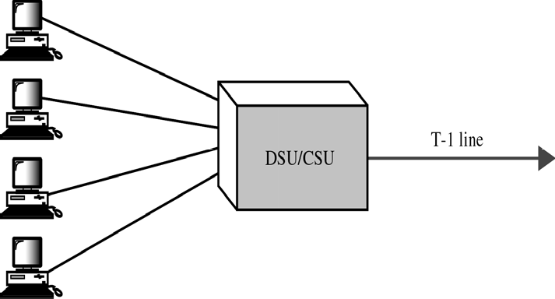
CS601-Data Communication
VU
Fractional T Lines (Figures)
Many subscribers do not need the entire capacity of the T line
For example, a small business may need only one-fourth of the capacity of a T-1 line
If four business of same size lie in same building, they can share a T-1 line
DSU/CSU allow the capacity of T-1 line to be interleaved into 4 channels
E-Lines
*Europeans use a version of T-lines called E-lines
*Two are conceptually identical but capacities vary
Line Rate(Mbps) Voice channels
------------------------------------------------
E-1 | 2.048 | 30
E-2 | 8.448 | 120
E-3 | 34.368 | 480
E-4 | 139.264 | 1920
Fiber to the Curb (FTTC)
*Optical fiber has many advantages:
–Noise Resistance
–High BW Capacity
*Very Expensive
*Telephone & Cable companies have devise FTTC to employ optical fiber while keeping the expense down
*Optical Fiber is the medium from the Central Office of the telephone company
or from main office of a cable company to the Curb
*The medium from the Curb to the subscriber’s premises if the less expensive twisted pair or coaxial cable
FTTC in Telephone Network
Optical Fiber is used to connect and multiplex different voice channels
Copper twisted pair coming from individual premises is multiplexed in junction boxes and converted to optical signals. Optical signals are

Slide 8
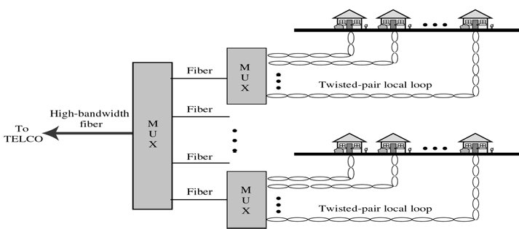
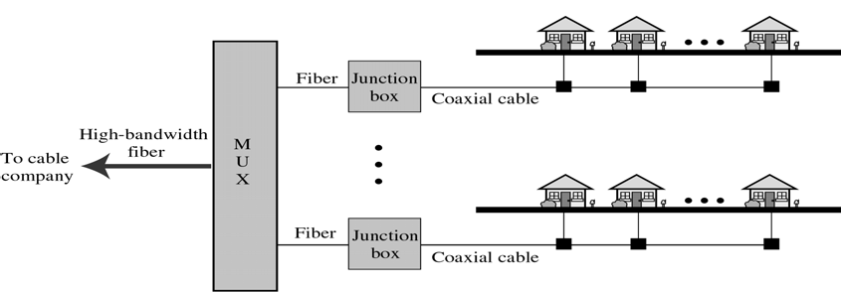
CS601-Data Communication
VU
multiplexed using WDM at switching office to create wider BW optical
FTTC in Cable TV Network
Cable TV uses optical fibers to connect and multiplex different cable channels
Coaxial cables coming from individual premises are multiplexed in the junction box and converted to the optical signals
Optical signals are multiplexed using WDM at switching office to create wider BW optical signals
ERROR DETECTION AND CORRECTION
Introduction
Networks must be able to transfer data from one device to another with complete accuracy
A system that cannot guarantee that the data received by one device is identical to the data transmitted by another device is essentially useless
Anytime the data is TX from source to destination, it gets corrupted on the way
Many factors including NOISE can alter or wipe out one or more bits of a given data unit
Reliable systems must have a mechanism for detecting and correcting such ERRORS
Error detection and Correction is implemented either at the data link layer or at the Transport layer
Types of Errors

Slide 9
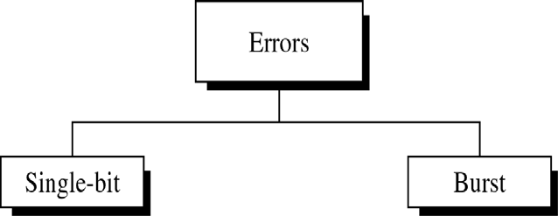
CS601-Data Communication
VU
Whenever an EM signal flows from one point to the other, it is subject to unpredictable interference from heat, magnetism and other forms of electricity
This interference can change the shape or timing of the signal
If the signal is carrying encoded binary data, such changes can alter the meaning of the data
Summary
T-Lines in Analog Transmission
Fractional T-Lines
E-Lines
Fiber To The Curb (FTTC)
Error Detection and Correction
Reading Sections
Section 8.5, 8.7, 9.1,
“Data Communications and Networking” 4th Edition by Behrouz A. Forouzan

Slide 10
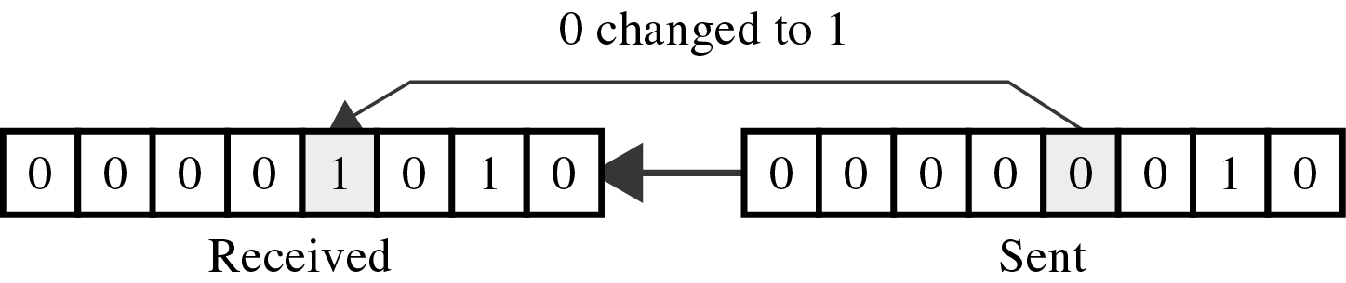
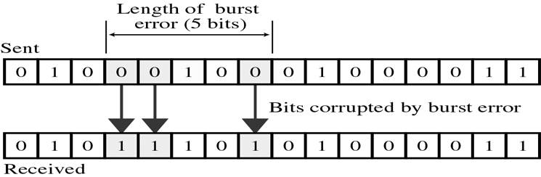
CS601-Data Communication
VU
LECTURE #33
Types of Errors
Single Bit & Burst
In a single-bit error, a 0 is changed to a 1 or a 1 to a 0
In a burst error multiple bits are changed
For Example, a 0.01 second burst of impulse noise on a TX with a data rate of 1200 bps might change all or some of 12 bits of information
The term single bit error means that only one bit of a given data unit (such as a byte, character, or a packet) is changed from 1 to 0 or from 0 to 1
Figure shows the effect of a single bit error on a data unit
ASCII character 000000010 (ASCII STX) is sent but 00001010 (ASCII LF) is received
Single bit errors are the least likely type of error in serial data TX
To see Why? Imagine a sender sends data at 1Mbps
This means that each bit lasts only 1/1,000,000 seconds or 1 microsecond
For single bit error to occur, the noise must have a duration of 1 microsecond which is very rare, noise lasts much longer than that
However, single bit error can occur if we are sending data using parallel TX
For Example, if 8 wires are used to send all of the eight bits of a byte at the same time and one of the wires is noise, one bit can be corrupted in each byte
Burst Errors
*The term burst error means that two or more bit sin the data unit have changed from 1 to 0 or from 0 to 1
Figure shows the effect of a burst error on a data unit
In this case 0100010001000011 was sent but 0101110101000011 was received
Note that a burst error does not necessarily mean that error occur in consecutive bits

Slide 11
CS601-Data Communication VU
The length of the burst is measured from the first corrupted bit to the last corrupted bit
Some bits in b/w may not have been corrupted
Burst error is most likely to happen in a serial TX
The duration of the noise is normally longer than the duration of a bit which means that when noise affects data, it affects a set of bits
The number of bits affected depends on the data rate and duration of noise
For example, if we are sending data at 1 Kbps, a noise of 1/100 seconds can affect 10 bits
If we are sending data at 1 Mbps, the same noise can affect 10,000 bits
Error Detection
Even if we know what type of errors can occur, will we recognize one when we see it?
If we have a copy of the intended TX for comparison, of course we will
But what if we don’t have a copy of the original
Then we will have no way of knowing we have received an error until we have decoded the TX and failed to make sense of it
For a device to check for errors this way will be Costly and Slow
We don’t need a machine that decodes every thing and then sits and decides whether a specific word makes sense or not
We need a mechanism that is Simple and Completely objective
Redundancy
One error detection mechanism that would satisfy these requirements would be to send every data unit twice
The receiving device would then be able to do a bit-for-bit comparison b/w two TXs
Any discrepancy will indicate an error and an appropriate error correction mechanism could be set in place
This system will be completely Accurate because the odds of error affecting the same bits in both version will be infinitesimally small
But this system will be extra ordinarily SLOW
Not only will the TX time double, but the time it takes to compare two data units is also added up
The concept of including extra information in the TX solely for the purpose of comparison is a good one
But instead of repeating the entire data stream, a shorter group of bits may be appended to the end of each unit
This technique is called REDUNDANCY because the extra bit are redundant to the information and are discarded as soon as the accuracy of TX has been determined
170

Slide 12
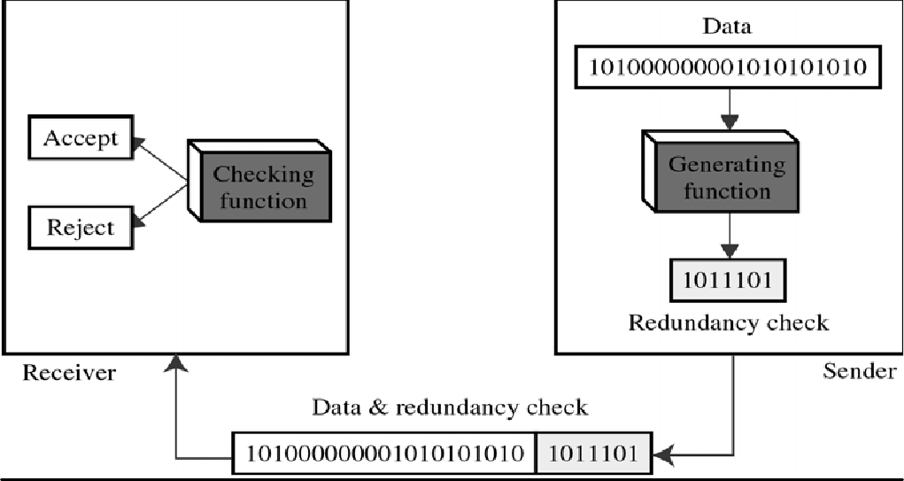
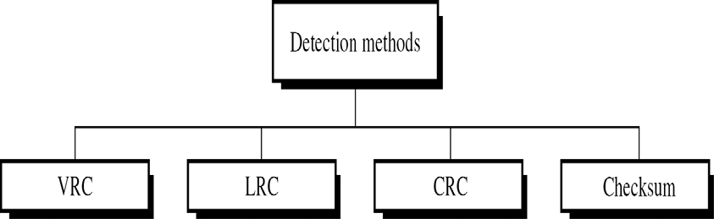
CS601-Data Communication
VU
Fig shows the process of using redundant bits to check the accuracy of data unit
Once the data stream has been generated, it passes through a device that analyzes it and adds on an appropriately coded redundancy check
The data unit now enlarged by several bits (7) travels over the link to the receiver
The receiver puts the entire stream through a checking function
If the received bit stream passes the checking criteria, the data portion of the data unit is accepted and the redundant bits are discarded
Types of Redundancy Checks
o There are 4 types of redundancy checks used in data communication:
–Vertical Redundancy Check (VRC)
–Longitudinal Redundancy Check (LRC)
–Cyclic Redundancy Check (CRC)
–Checksum
First 3 are normally implemented in the physical layer for use in data link layer
Fourth is used by Upper layers
Vertical Redundancy Check (VRC)
Most common and least expensive
Also called Parity Check
A redundant bit called parity bit is appended to every data unit so that total number of 1’s in the unit becomes even including the parity bit

Slide 13
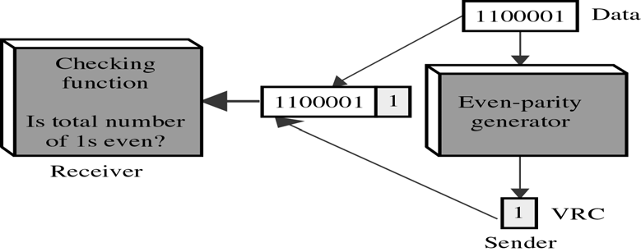
CS601-Data Communication
VU
*We want to TX the binary data unit 1100001
*Adding together the number of 1’s gives us 3, an odd number
Before TX, we pass the data unit through a parity generator, which counts the 1’s and appends the parity bit (1) to the end
The total number of 1’s is now 4, an even number
The system now transfers the entire expanded across the network link
When it reaches its destination, the RX puts all 8 bits through an even parity checking function
If the RX sees 11100001, it counts four ones, an even number and the data unit passes
But what if the data unit has been damaged in transit?
What if instead of 11100001, receiver sees 11100101?
Then when the parity checker counts the 1’s, it gets 5 an odd number
The receiver knows that an error has occurred somewhere and therefore rejects the whole unit
Some systems may also use ODD parity checking
The principal is the same as even parity
✓ Example 9.1, 9.2, 9.3
Example 9.1
Sender wants to send “world” In ASCII, the five characters are coded as:
1110111 | w | 1110111 0
1101111 | o | 1101111 0
1110010 | r | 1110010 0
1101100 | l | 1101100 0
1100100 | d | 1100100 1
Example 9.2
| Suppose “world” is received by the receiver without being corrupted:
Receiver counts the 1’s and passes it
1110111 | w | 1110111 0 6
1101111 | o | 1101111 0 6
1110010 | r | 1110010 0 4
1101100 | l | 1101100 0 4
1100100 | d | 1100100 1 4

Slide 14
CS601-Data Communication
VU
Example 9.3
Suppose “world” is received by the receiver corrupted:
Receiver counts the 1’s and rejects it
1110111 | w | 1111111 0 7
1101111 | o | 1101111 0 6
1110010 | r | 1110110 0 5
1101100 | l | 1101100 0 4
Performance of VRC
VRC can detect all single bit errors
Can also detect Burst errors as long as the total number of bits changed is ODD (1,3,5 etc)
Examples
We have an Even Parity data unit where the total number of 1’s including the parity bit is ‘6’ : 1000111011
If 3 bits change value resulting parity will be odd and an error will be detected: 1111111011: 1’s = 9
If 2 bits change value resulting parity will still be even and error will not be detected: 1110111011: 1’s = 8
VRC cannot detect errors when the total number of bits changed are even
VRC checker will return a result of 1 and the data unit will be rejected
The same hold true for any odd number of errors
In the second case, VRC checker will check parity and will return an even number although the data unit contains two errors
VRC cannot detect error when the number of bits changed is even
If any two bits change in TX, the changes cancel each other and the data unit will pass a parity check even though the data unit is damaged
Same holds true for any even number of errors
Summary
Types of Errors
Error Detection Techniques
Redundancy
Types of Redundancy Checks
Reading Sections
* Section 9.1, 9.2, 9.3
“Data Communications and Networking” 4th Edition by Behrouz A. Forouzan

Slide 15
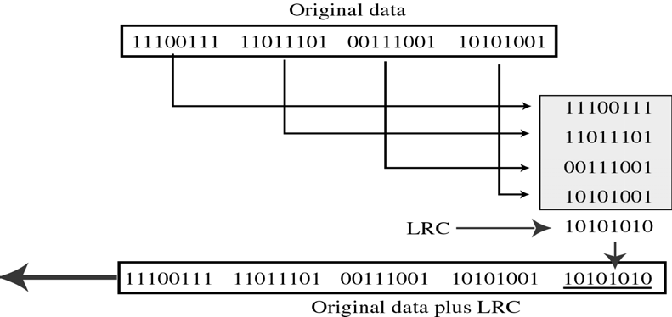
CS601-Data Communication
VU
LECTURE #34
Error Detection And Correction Methods
Longitudinal Red Check(LRC)
In LRC, a block of bits is organized in a table (rows and columns)
For example instead of sending 32 bits, we organize them in a table made of 4 rows and 8 columns
We then calculate the Parity bit for each column and create a new row of 8 bits which are the parity bits for the whole block
Note that the first parity bit in the 5th row is calculated based on all the first bits
The second parity bit is calculated based on all the second bits and so on
We then attach the 8 parity bits to the original data and send them to the receiver
Example 9.4
Suppose the following block is sent: 10101001
00111001
11011101
11100111
10101010 (LRC)
* It is hit by a burst of length 8 and some bits are corrupted: 10100011
10001001
11011101
11100111
10101010 (LRC)
* Receiver checks LRC, some of bits do not follow even parity rule and whole block is discarded

Slide 16
CS601-Data Communication
VU
10100011
10001001
11011101
11100111
10101010 (LRC)
Performance of LRC
Burst errors can be detected more often
As shown in the last example, an LRC of ‘n; bits can easily detect a burst error of ‘n’ bits
A burst error of more than ‘n’ bits is also detected by LRC with a very high probability
One pattern of errors remain elusive
If two bits in one data unit are changed and two bits in exactly the same place in another data unit are also damaged
For Example:
Original data units
11110000
11000011
Changed data units 01110001
01000010
Cyclic Redundancy Check (CRC)
Most powerful of checking techniques
VRC and LRC are based on Addition
CRC is based on Binary Division
A sequence of redundant bits called CRC or CRC remainder is appended to the end of the data unit, so that the resulting data unit becomes exactly divisible by a second predetermined binary number
At its destination, the data unit is divided by the same number
If at this step, there is no remainder, the incoming data unit is assumed to be intact and is therefore accepted
A remainder indicates that a data unit has been damaged and therefore must be rejected
Qualities of CRC
*To be valid the CRC must have two qualities:
–It must have exactly one less bit than the divisor
–Appending it to the end of the data must make the resulting bit sequence exactly divisible by the divisor

Slide 17
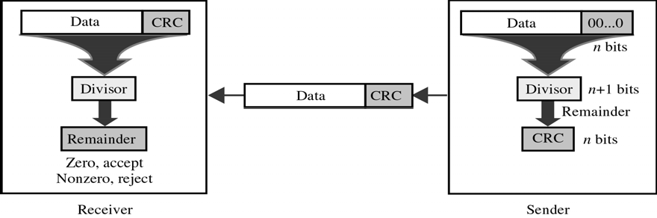
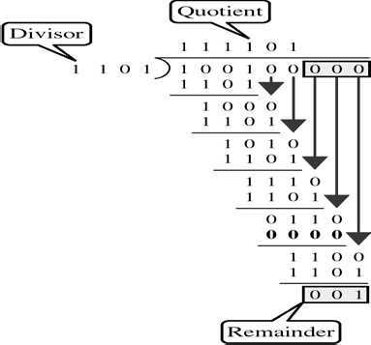
CS601-Data Communication
VU
*First a string of n 0’s is appended to the data unit
*The number ‘n’ is one less than the number of bits in the predetermined divisor, which is n+1 bits
*Secondly, newly elongated data unit is divided by the divisor using a process called
binary division. The remainder resulting from this division is the CRC
*Third,the CRC of ‘n’ bits replaces the appended 0’s at the end of the data unit
*Note that CRC may consist of all zeros
*The data unit arrives at the receiver followed by the CRC
*The receiver treats the whole string as a unit and divides it by the same divisor that was used to find the CRC remainder
*If string arrives without an error, the CRC checker yields a remainder of zero and data
unit passes
*If the string has been changed in transit, the division yields a non-zero remainder and the data unit does not pass
The CRC Generator
*Uses Modulo-2 Division
The CRC Checker
*Functions exactly like CRC Generator

Slide 18
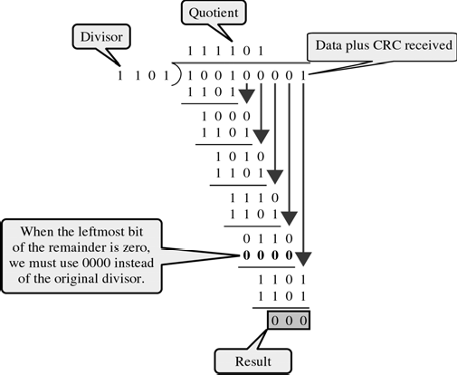
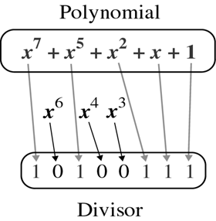

CS601-Data Communication
VU
Polynomials
CRC generator ( the divisor) is most often represented not as a string of 1’s and 0’s but as an algebraic polynomial
The polynomial format is useful for two reasons:
–It is short
–Can be used to prove the concept mathematically
Selection of a Polynomial
o A polynomial should have the following properties:
–It should not be divisible by ‘x’
–It should be divisible by ‘x+1’
*The first condition guarantees that all burst errors of a length equal to the degree of the polynomial are detected
*The 2nd guarantees that all burst errors affecting an odd number of bits are detected

Slide 19
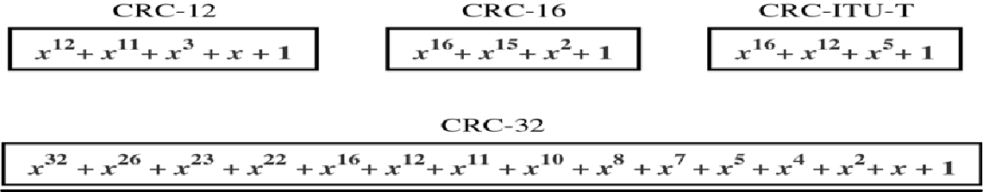
CS601-Data Communication
VU
Popular Polynomials for CRC
Performance of CRC
CRC can detect all burst errors that affect an odd number of errors
CRC can detect all burst errors of length less than or equal to the degree of the polynomial
CRC can detect with a very high probability burst errors of length greater than the degree of the polynomial
Example 9.6
_{x} 12 _{+ x} 11
The CRC-12 (
It will detect
+ x ³ + x + 1
) has a degree of 12
All burst errors affecting odd no. of bits
All burst errors with a length equal to or less than 12
99.97 % of the time burst errors with a length of 12 or more
Summary
Types of Redundancy Checks
Longitudinal Redundancy Check (LRC)
Cyclic Redundancy Check (CRC)
Reading Section
Section 9.4, 9.5
“Data Communications and Networking” 4th Edition by Behrouz A. Forouzan

Slide 20
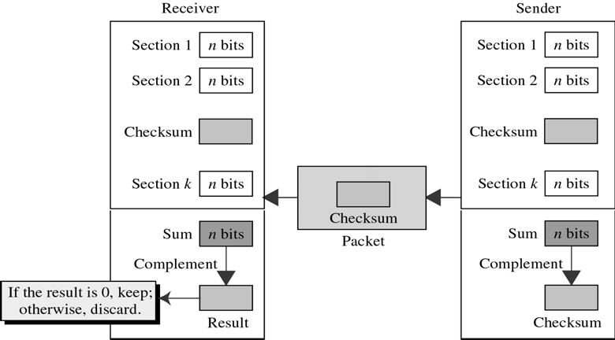
CS601-Data Communication
VU
LECTURE #35
Error Correction And Detection Method
CHECKSUM
Error detection method used by the Higher Layers
Like VRC, LRC, CRC, Checksum is also based on the concept of redundancy
One’s Complement
Finding one’s complement
Invert every 1 to 0 and 0 to 1
A and –A are one’s complement of each other
– +A = 1010 → -A = 0101
– +0 = 0000 → -0 = 1111
Error detection method used by the Higher Layers
Like VRC, LRC, CRC, Checksum is also based on the concept of redundancy
CHECKSUM Generator
The sender subdivides data units into equal segments of ‘n’ bits(16 bits)
These segments are added together using one’s complement
The total (sum) is then complemented and appended to the end of the original data unit as redundancy bits called CHECKSUM
The extended data unit is transmitted across the network
The receiver subdivides data unit as above and adds all segments together and complement the result
If the intended data unit is intact, total value found by adding the data segments and the checksum field should be zero
If the result is not zero, the packet contains an error & the receiver rejects it
Checksum Figure

Slide 21
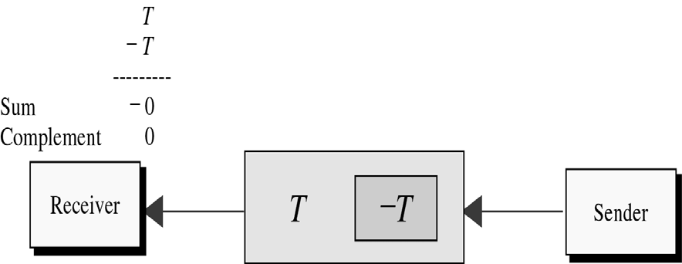
CS601-Data Communication
VU
Performance of Checksum
Detects all errors involving an odd number of bits
Detects most errors involving an even number of bits
One pattern remains elusive
Examples Example 9.7
* Suppose a block of 16 bits need to be sent: 10101001 00111001 10101001
00111001
---------------- 11100010 Sum
00011101 Checksum
Sent pattern:
10101001 00111001 00011101
checksum
Example 9.8
Examples of no error and a burst error
Segment 1
Segment 2 Checksum
10101001 Segment1
00111001 Segment2
00011101 Checksum
10101111
11111001
00011101
----------------- ----------------
Sum 11111111 Sum
11000110
00111001
Complement 00000000 Complement
* Error is invisible if a bit inversion is balanced by an opposite bit inversion in the corresponding digit of another segment
Segment1 10111101
180

Slide 22
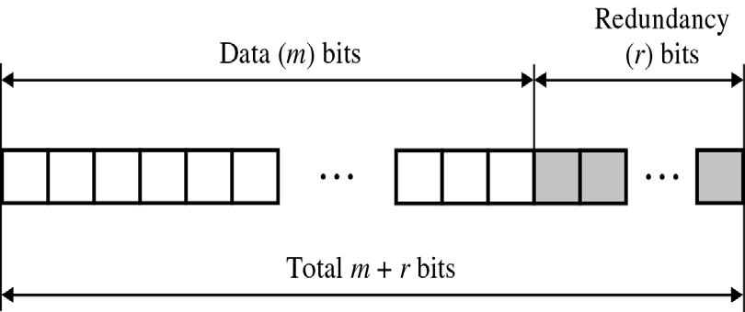
CS601-Data Communication
VU
Segment2 Checksum
00101001
00011001
---------------------- 11111111
Sum
→ The error is undetected
ERROR CORRECTION
Mechanisms that we have studied all detect errors but do not correct them
Error correction can be done in two ways:
–Receiver can ask Sender for Re- TX
–Receiver can use an error-detecting code, which automatically correct certain errors
Error correcting code are more sophisticated than error detecting codes
They require more redundancy bits
The number of bits required to correct multiple –bit or burst error is so high that in most cases it is inefficient
Error correction is limited to 1, 2 or 3 bit
Single-bit Error Correction
*Simplest case of error correction
Error correction requires more redundancy bits than error detection
One additional bit can detect single-bit errors
Parity bit in VRC
One bit for two states: error or no error
To correct the error, more bits are required
Error correction locates the invalid bit or bits
8 states for 7-bit data: no error, error in bit 1, and so on
Looks like three bits of redundancy is adequate
What if an error occurs in the redundancy bits?
Hamming Code
Redundancy Bits (r)
r must be able to indicate at least m+r+1 states
m+r+1 states must be discoverable by r bits
Therefore, 2r ≥ m+r+1
o If m=7, r=4 as 24 ≥ 7+4+1

Slide 23
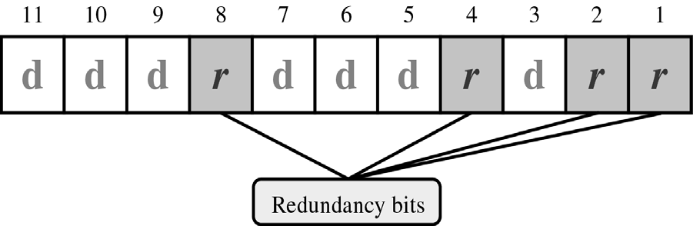
CS601-Data Communication
VU
Hamming Code
Each r bit is the VRC bit for one combination of data bits
r1(r2) bit is calculated using all bit positions whose binary representation includes a 1 in the first(second) position, and so on
Summary
Checksum
Single-Bit Error Correction
Hamming Code
Reading Sections
Section 9.6, 9.7, “Data Communications and Networking” 4th Edition by Behrouz
Forouzan

